Slide 1


中微子振荡的物质效应与重正化群方程
周顺
(高能所&国科大)
粒子物理前沿问题研讨会, 中山大学, 广州
2019-01-24

Slide 2
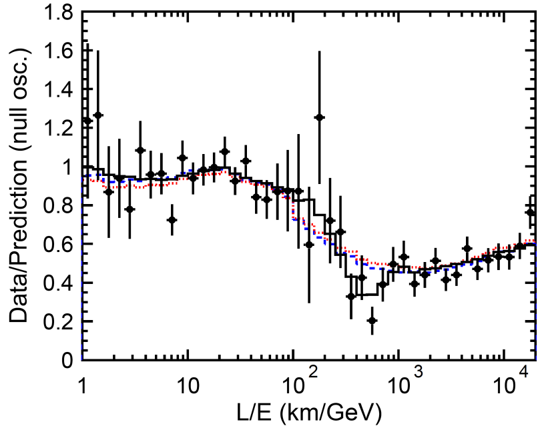

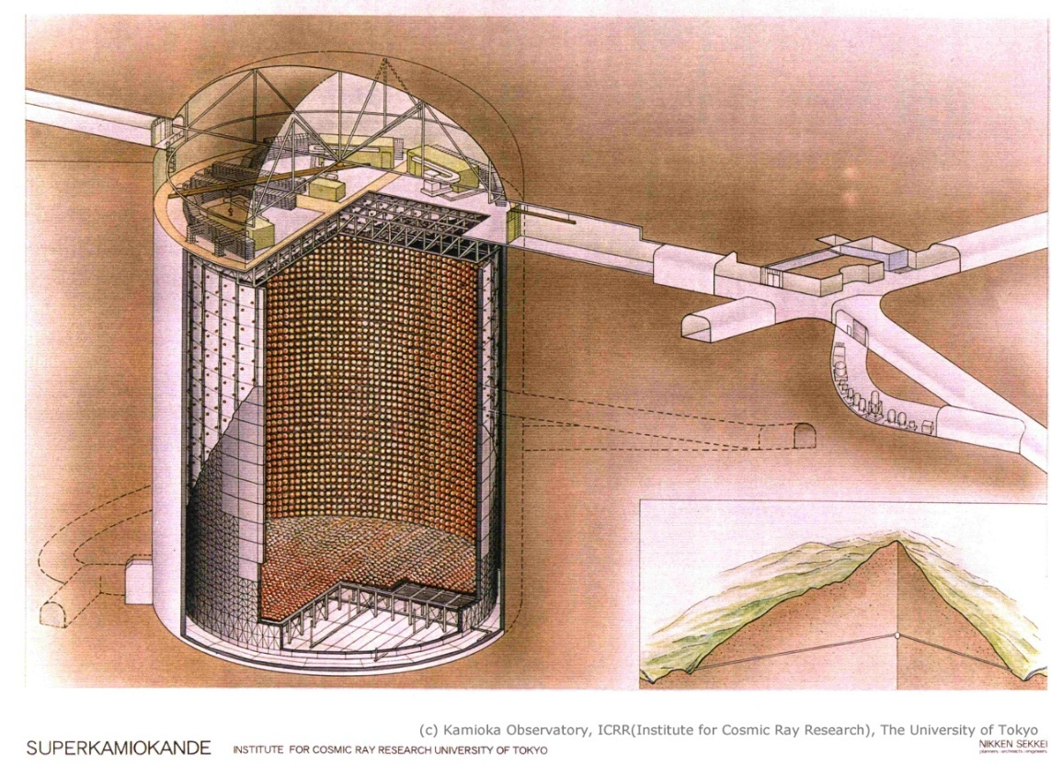
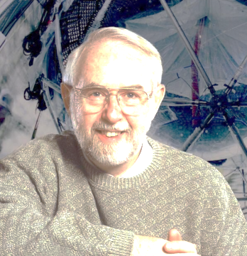
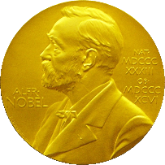
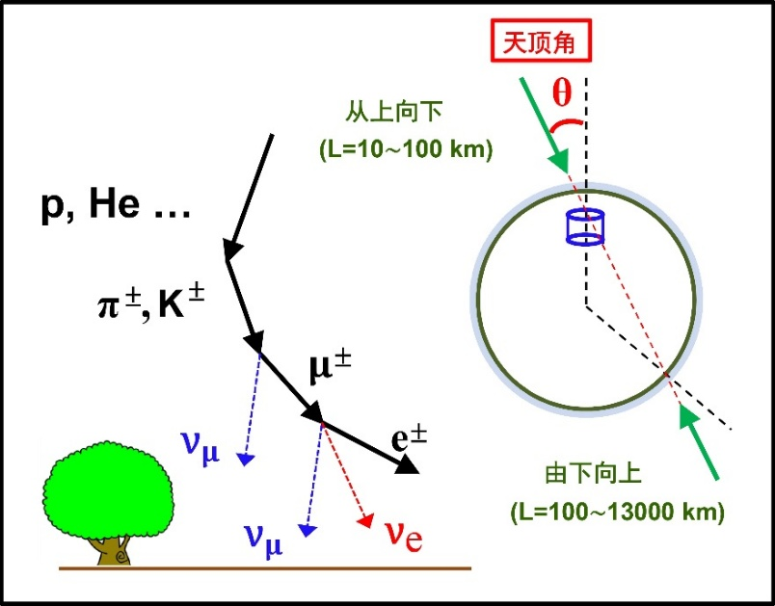
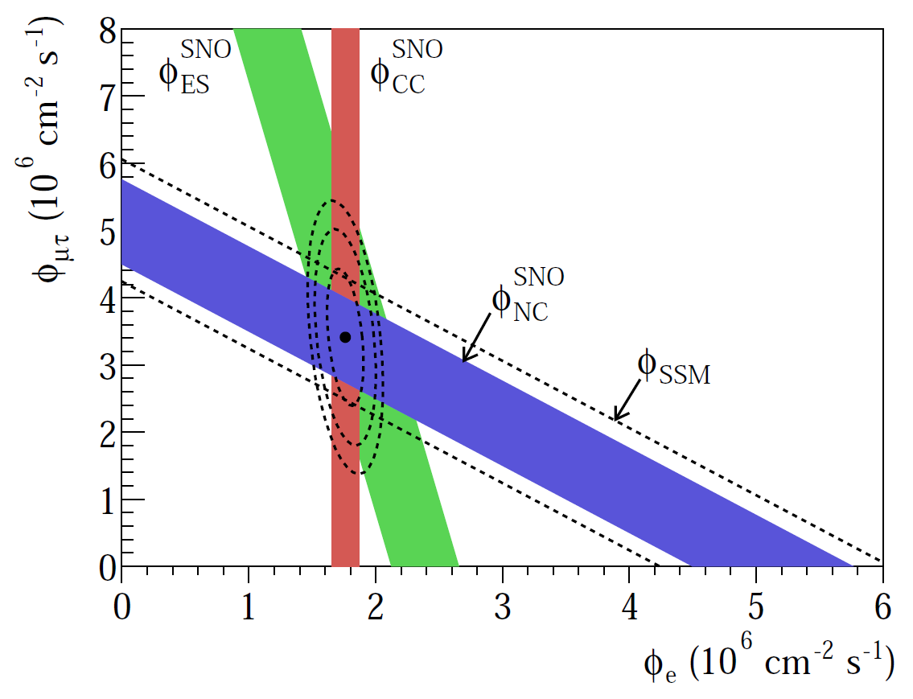
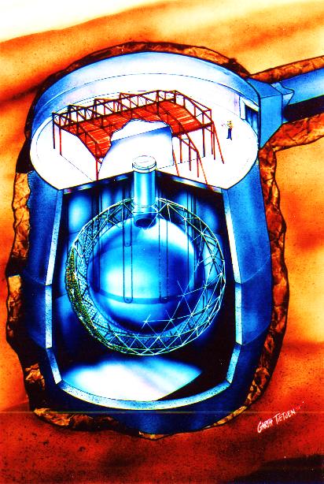
Discovery of Neutrino Oscillations
01
Nobel Prize
in Physics 15
Takaaki Kajita
Super-Kamiokande
Arthur McDonald
Sudbury Neutrino Observatory

Slide 3
Status of Neutrino Oscillations
02
m₁ < m₂ < m₃ (NO) or m₃ < m₁ < m₂ (IO)
Neutrino mass ordering: normal ordering favored at the 2~3σ C.L.

Slide 4
Status of Neutrino Oscillations
03
m₁ < m₂ < m₃ (NO) or m₃ < m₁ < m₂ (IO)
Neutrino mass ordering: normal ordering favored at the 2~3σ C.L.

Slide 5
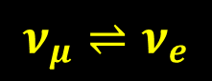



Sensitivity to Mass Ordering
04
C. Giunti, NNN 2018
MSW Resonance
$$2V_{e}E=Δm_{31}^{2}cos2θ_{13}$$
Global-fit analysis
$$ν_{μ}⇌ν_{e}$$
NO: $Δm_{31}^{2}>0$
Resonant
enhancement
IO: $Δm_{31}^{2}<0$

Slide 6
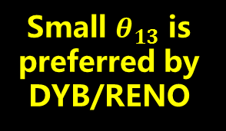


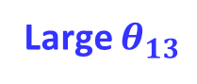
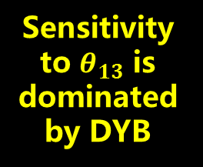
Sensitivity to Mass Ordering
05
Sensitivity
to $θ_{13}$ is
dominated
by DYB
Large $θ_{13}$ is
preferred by T2K/NOvA
Large $θ_{13}$
Small $θ_{13}$
Acc., LBL
+Reactor
Small $θ_{13}$ is
preferred by DYB/RENO

Slide 7
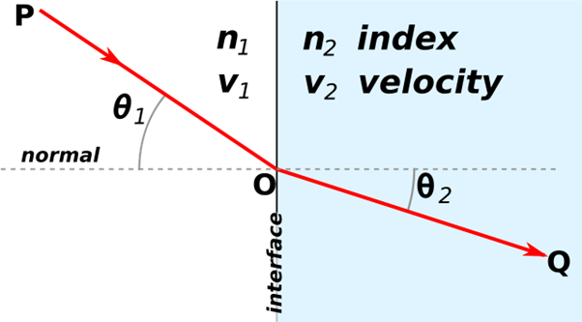

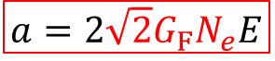
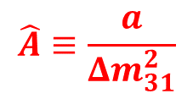
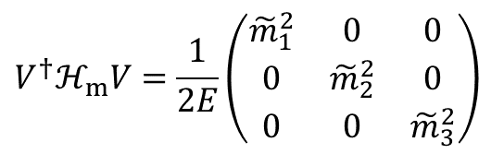
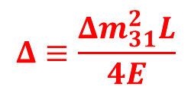
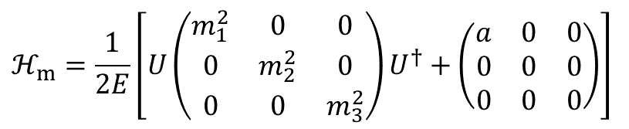
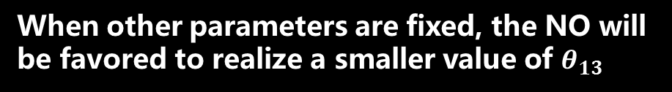
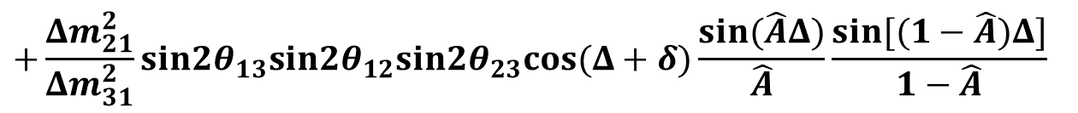
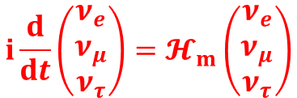
Matter Effects on Neutrino Oscillations
06
$$i\frac{d}{dt}\left(\begin{matrix}ν_{e} \\ ν_{μ} \\ ν_{τ}\end{matrix}\right)=𝓗_{m}\left(\begin{matrix}ν_{e} \\ ν_{μ} \\ ν_{τ}\end{matrix}\right)$$
$$a=2{\sqrt{2}G}_{F}N_{e}E$$
$$ℋ_{m}=\frac{1}{2E}\left[U\left(\begin{matrix}m_{1}^{2} & 0 & 0 \\ 0 & m_{2}^{2} & 0 \\ 0 & 0 & m_{3}^{2}\end{matrix}\right)U^{†}+\left(\begin{matrix}a & 0 & 0 \\ 0 & 0 & 0 \\ 0 & 0 & 0\end{matrix}\right)\right]$$
$$V^{†}ℋ_{m}V=\frac{1}{2E}\left(\begin{matrix}{\tilde{m}}_{1}^{2} & 0 & 0 \\ 0 & {\tilde{m}}_{2}^{2} & 0 \\ 0 & 0 & {\tilde{m}}_{3}^{2}\end{matrix}\right)$$
$$P\left(ν_{μ}→ν_{e}\right)≃\sin^{2}2θ_{13}\sin^{2}θ_{23}\frac{\sin^{2}\left[\left(1−\hat{A}\right)Δ\right]}{{\left(1−\hat{A}\right)}^{2}}$$
$$Δ≡\frac{Δm_{31}^{2}L}{4E}$$
$$\hat{A}≡\frac{a}{Δm_{31}^{2}}$$
Large $θ_{13}$
from T2K/NOvA
$$+\frac{Δm_{21}^{2}}{Δm_{31}^{2}}sin2θ_{13}sin2θ_{12}sin2θ_{23}cos(Δ+δ)\frac{sin(\hat{A}Δ)}{\hat{A}}\frac{sin[(1−\hat{A})Δ]}{1−\hat{A}}$$
Sensitivity to Mass Ordering
When other parameters are fixed, the NO will be favored to realize a smaller value of $θ_{13}$
M
S
W

Slide 8

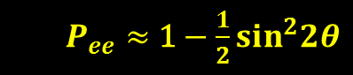
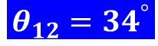
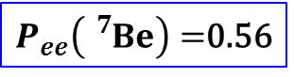
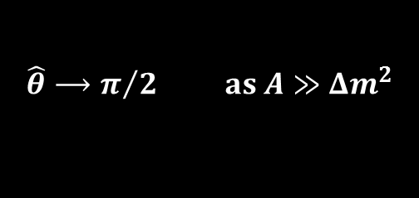

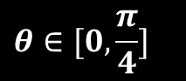
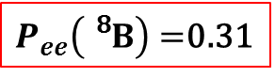
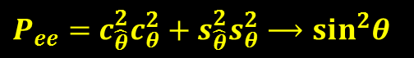
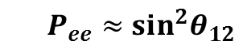
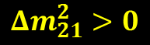

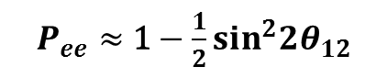

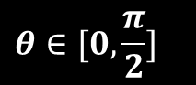
Matter Effects on Neutrino Oscillations
07
For high-energy ⁸B neutrinos
at production r = 0
Vacuum oscillation
$$\left(\begin{matrix}\left.|{\tilde{ν}}_{1}(0)\right\rangle \\ \left.|{\tilde{ν}}_{2}(0)\right\rangle \end{matrix}\right)=\left(\begin{matrix}c_{\hat{θ}} & {−s}_{\hat{θ}} \\ s_{\hat{θ}} & c_{\hat{θ}}\end{matrix}\right)\left(\begin{matrix}\left.|ν_{e}(0)\right\rangle \\ \left.|ν_{μ}(0)\right\rangle \end{matrix}\right)$$
$P_{ee}≈$ 1 $−$ $\frac{1}{2}\sin^{2}2θ_{12}$
adiabatic evolution
$$\left(\begin{matrix}\left.|{\tilde{ν}}_{1}(R)\right\rangle \\ \left.|{\tilde{ν}}_{2}(R)\right\rangle \end{matrix}\right)=\left(\begin{matrix}1 & 0 \\ 0 & 1\end{matrix}\right)\left(\begin{matrix}\left.|{\tilde{ν}}_{1}(0)\right\rangle \\ \left.|{\tilde{ν}}_{2}(0)\right\rangle \end{matrix}\right)$$
$P_{ee}≈$ $\sin^{2}θ_{12}$
$P_{ee}\left({}_{}^{7}{Be}\right)=$0.56
on the solar surface r = R
MSW
$$\left(\begin{matrix}\left.|ν_{e}(R)\right\rangle \\ \left.|ν_{μ}(R)\right\rangle \end{matrix}\right)=\left(\begin{matrix}c_{θ} & s_{θ} \\ {−s}_{θ} & c_{θ}\end{matrix}\right)\left(\begin{matrix}\left.|{\tilde{ν}}_{1}(R)\right\rangle \\ \left.|{\tilde{ν}}_{2}(R)\right\rangle \end{matrix}\right)$$
$P_{ee}\left({}_{}^{8}B\right)=$0.31
survival probability
$P_{ee}=$ $c_{\hat{θ}}^{2}c_{θ}^{2}+s_{\hat{θ}}^{2}s_{θ}^{2}⟶\sin^{2}θ$
$$\hat{θ}⟶π/2 as A≫Δm^{2}$$
For the MSW resonance to happen
For low-energy ⁷Be neutrinos
$$θ∈[0, \frac{π}{2}]$$
$$θ∈[0,\frac{π}{4}]$$
$$θ_{12}={34}^{°}$$
$P_{ee}≈$ 1 $−$ $\frac{1}{2}\sin^{2}2θ$
Normal neutrino mass ordering
$${Δm}_{21}^{2}>0$$
$${Δm}_{21}^{2}$$
Oscillations in vacuum

Slide 9
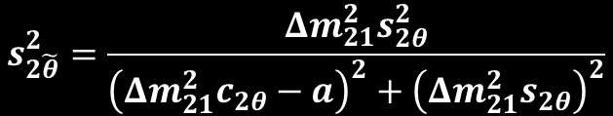
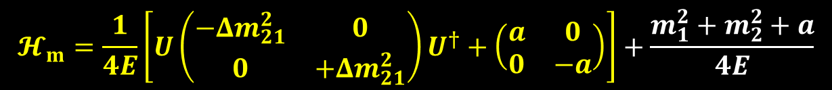


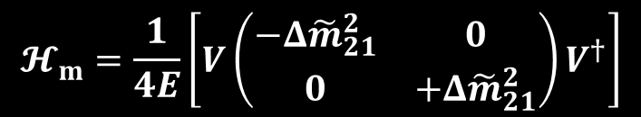
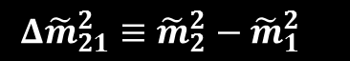

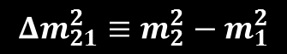
Matter Effects on Neutrino Oscillations
08
An example for two-flavor neutrino mixing
$$𝓗_{m}=\frac{1}{2E}U\left(\begin{matrix}m_{1}^{2} & 0 \\ 0 & m_{2}^{2}\end{matrix}\right)U^{†}+\left(\begin{matrix}V_{e} & 0 \\ 0 & 0\end{matrix}\right)=\frac{1}{2E}\left[U\left(\begin{matrix}m_{1}^{2} & 0 \\ 0 & m_{2}^{2}\end{matrix}\right)U^{†}+\left(\begin{matrix}a & 0 \\ 0 & 0\end{matrix}\right)\right]$$
The effective Hamiltonian in a more compact form:
$$𝓗_{m}=\frac{1}{4E}\left[U\left(\begin{matrix}{−Δm}_{21}^{2} & 0 \\ 0 & {+Δm}_{21}^{2}\end{matrix}\right)U^{†}+\left(\begin{matrix}a & 0 \\ 0 & −a\end{matrix}\right)\right]+\frac{m_{1}^{2}+m_{2}^{2}+a}{4E}$$
$${Δm}_{21}^{2}≡m_{2}^{2}−m_{1}^{2}$$
$$𝓗_{m}=\frac{1}{4E}\left(\begin{matrix}{a−Δm}_{21}^{2}c_{2θ} & {Δm}_{21}^{2}s_{2θ} \\ {Δm}_{21}^{2}s_{2θ} & {Δm}_{21}^{2}c_{2θ}−a\end{matrix}\right)$$
$${Δ\tilde{m}}_{21}^{2}≡{\tilde{m}}_{2}^{2}−{\tilde{m}}_{1}^{2}$$
Converted into the mass basis
Mixing matrix & mass states in matter
$$𝓗_{m}=\frac{1}{4E}\left[V\left(\begin{matrix}−Δ{\tilde{m}}_{21}^{2} & 0 \\ 0 & +Δ{\tilde{m}}_{21}^{2}\end{matrix}\right)V^{†}\right]$$
$$\left(\begin{matrix}\left.|ν_{e}\right\rangle \\ \left.|ν_{μ}\right\rangle \end{matrix}\right)=\left(\begin{matrix}c_{\tilde{θ}} & s_{\tilde{θ}} \\ {−s}_{\tilde{θ}} & c_{\tilde{θ}}\end{matrix}\right)\left(\begin{matrix}\left.|{\tilde{ν}}_{1}\right\rangle \\ \left.|{\tilde{ν}}_{2}\right\rangle \end{matrix}\right)≡\tilde{U}\left(\begin{matrix}\left.|{\tilde{ν}}_{1}\right\rangle \\ \left.|{\tilde{ν}}_{2}\right\rangle \end{matrix}\right)$$
$$s_{2\tilde{θ}}^{2}=\frac{{Δm}_{21}^{2}s_{2θ}^{2}}{{\left({Δm}_{21}^{2}c_{2θ}−a\right)}^{2}+{\left({Δm}_{21}^{2}s_{2θ}\right)}^{2}}$$
$$Δ{\tilde{m}}_{21}^{2}=\sqrt{{\left({Δm}_{21}^{2}c_{2θ}−a\right)}^{2}+{\left({Δm}_{21}^{2}s_{2θ}\right)}^{2}}$$
Relationship between the mixing angle (mass difference) in vacuum and that in matter

Slide 10
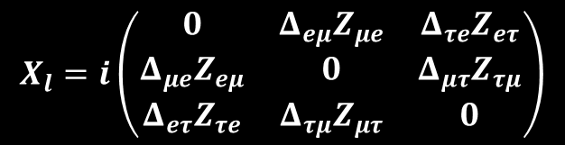
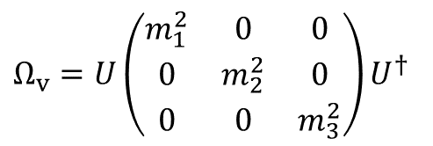
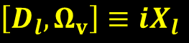

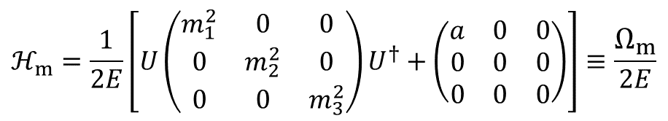
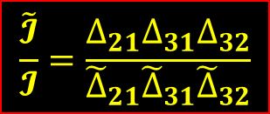
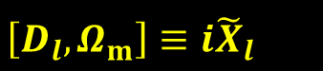

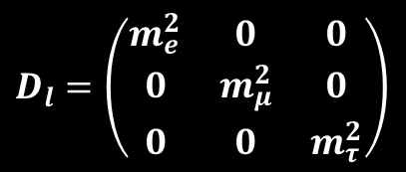


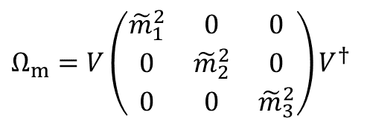
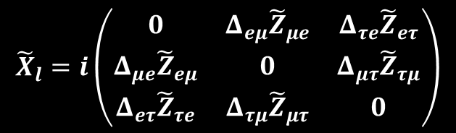
Matter Effects on Neutrino Oscillations
09
A: Establish the relationship between intrinsic and effective parameters
$$ℋ_{m}=\frac{1}{2E}\left[U\left(\begin{matrix}m_{1}^{2} & 0 & 0 \\ 0 & m_{2}^{2} & 0 \\ 0 & 0 & m_{3}^{2}\end{matrix}\right)U^{†}+\left(\begin{matrix}a & 0 & 0 \\ 0 & 0 & 0 \\ 0 & 0 & 0\end{matrix}\right)\right]≡\frac{Ω_{m}}{2E}$$
$$Ω_{v}=U\left(\begin{matrix}m_{1}^{2} & 0 & 0 \\ 0 & m_{2}^{2} & 0 \\ 0 & 0 & m_{3}^{2}\end{matrix}\right)U^{†}$$
$$D_{l}=\left(\begin{matrix}m_{e}^{2} & 0 & 0 \\ 0 & m_{μ}^{2} & 0 \\ 0 & 0 & m_{τ}^{2}\end{matrix}\right)$$
$$Ω_{m}=V\left(\begin{matrix}{\tilde{m}}_{1}^{2} & 0 & 0 \\ 0 & {\tilde{m}}_{2}^{2} & 0 \\ 0 & 0 & {\tilde{m}}_{3}^{2}\end{matrix}\right)V^{†}$$
Calculate the commutators:
$$\left[D_{l},Ω_{m}\right]≡i{\tilde{X}}_{l}$$
$$\left[D_{l}, Ω_{v}\right]≡iX_{l}$$
$$X_{l}=i\left(\begin{matrix}0 & Δ_{eμ}Z_{μe} & Δ_{τe}Z_{eτ} \\ Δ_{μe}Z_{eμ} & 0 & Δ_{μτ}Z_{τμ} \\ Δ_{eτ}Z_{τe} & Δ_{τμ}Z_{μτ} & 0\end{matrix}\right)$$
$${\tilde{X}}_{l}=i\left(\begin{matrix}0 & Δ_{eμ}{\tilde{Z}}_{μe} & Δ_{τe}{\tilde{Z}}_{eτ} \\ Δ_{μe}{\tilde{Z}}_{eμ} & 0 & Δ_{μτ}{\tilde{Z}}_{τμ} \\ Δ_{eτ}{\tilde{Z}}_{τe} & Δ_{τμ}{\tilde{Z}}_{μτ} & 0\end{matrix}\right)$$
$$Δ_{αβ}≡m_{α}^{2}−m_{β}^{2}$$
$${\tilde{Z}}_{αβ}≡\sum_{i}{{\tilde{m}}_{i}^{2}}V_{αi}V_{βi}^{∗}$$
$$Z_{αβ}≡\sum_{i}{m_{i}^{2}}U_{αi}U_{βi}^{∗}$$
Harrison & Scott, PLB, 00;
Xing, PLB, 00
$$Δ_{ij}≡m_{i}^{2}−m_{j}^{2}$$
$$Det\left[X_{l} \right]=2iΔ_{μe}Δ_{τe}Δ_{τμ}Im\left[Z_{μe}Z_{τe}Z_{μτ}\right]=2iΔ_{μe}Δ_{τe}Δ_{τμ}Δ_{21}Δ_{31}Δ_{32}𝓘$$
$$\frac{\tilde{𝓘}}{𝓘}=\frac{Δ_{21}Δ_{31}Δ_{32}}{{\tilde{Δ}}_{21}{\tilde{Δ}}_{31}{\tilde{Δ}}_{32}}$$
$$Det\left[{\tilde{X}}_{l} \right]=2iΔ_{μe}Δ_{τe}Δ_{τμ}Im\left[{\tilde{Z}}_{μe}{\tilde{Z}}_{τe}{\tilde{Z}}_{μτ}\right]=2iΔ_{μe}Δ_{τe}Δ_{τμ}{\tilde{Δ}}_{21}{\tilde{Δ}}_{31}{\tilde{Δ}}_{32}\tilde{𝓘}$$

Slide 11
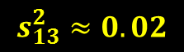
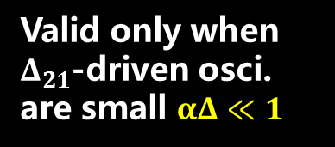

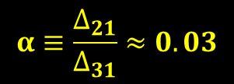
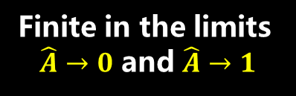
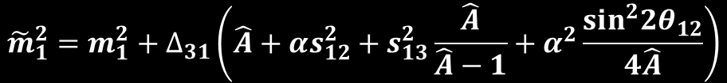






Matter Effects on Neutrino Oscillations
10
B: Series expansion of the effective parameters
Eigenvalues:
Freund, PRD, 01;
Akhmedov et al., JHEP, 04
$${\tilde{m}}_{1}^{2}=m_{1}^{2}+∆_{31}\left(\hat{A}+αs_{12}^{2}+s_{13}^{2}\frac{\hat{A}}{\hat{A}−1}+α^{2}\frac{\sin^{2}2θ_{12}}{4\hat{A}}\right)$$
$${\tilde{m}}_{2}^{2}=m_{1}^{2}+∆_{31}\left(αc_{12}^{2}−α^{2}\frac{\sin^{2}2θ_{12}}{4\hat{A}}\right)$$
$$α≡\frac{∆_{21}}{∆_{31}}≈0.03$$
up to the second
order of $α$ and $s_{13}^{2}$
$$s_{13}^{2}≈0.02$$
$${\tilde{m}}_{3}^{2}=m_{1}^{2}+∆_{31}\left(1−s_{13}^{2}\frac{\hat{A}}{\hat{A}−1}\right)$$
Divergent in the limits of $\hat{A}→0$ and $\hat{A}→1$
Oscillation Probabilities:
$${\tilde{P}}_{ee}=1−α^{2}\sin^{2}2θ_{12}\frac{\sin^{2}\hat{A}Δ}{{\hat{A}}^{2}}−4s_{13}^{2}\frac{\sin^{2}(\hat{A}−1)Δ}{{\left(\hat{A}−1\right)}^{2}}$$
Finite in the limits
$\hat{A}→0$ and $\hat{A}→1$
$${\tilde{P}}_{eμ}=α^{2}\sin^{2}2θ_{12}c_{23}^{2}\frac{\sin^{2}\hat{A}Δ}{{\hat{A}}^{2}}+4s_{13}^{2}s_{23}^{2}\frac{\sin^{2}(\hat{A}−1)Δ}{{\left(\hat{A}−1\right)}^{2}}$$
Valid only when $Δ_{21}$-driven osci.
are small $αΔ≪1$
$$+ 2α s_{13}sin2θ_{12} sin2θ_{23} cos\left(Δ−δ\right)\frac{sin\hat{A}Δ}{\hat{A}}\frac{sin(\hat{A}−1)Δ}{(\hat{A}−1)}$$
$$Δ≡\frac{Δ_{31}L}{4E}$$

Slide 12




A Differential Way to Understand Matter Effects
11
$$ℋ_{m}=\frac{1}{2E}\left[U\left(\begin{matrix}m_{1}^{2} & 0 & 0 \\ 0 & m_{2}^{2} & 0 \\ 0 & 0 & m_{3}^{2}\end{matrix}\right)U^{†}+\left(\begin{matrix}a & 0 & 0 \\ 0 & 0 & 0 \\ 0 & 0 & 0\end{matrix}\right)\right]$$
$$ℋ_{m}=\frac{1}{2E}\left[V\left(\begin{matrix}{\tilde{m}}_{1}^{2} & 0 & 0 \\ 0 & {\tilde{m}}_{2}^{2} & 0 \\ 0 & 0 & {\tilde{m}}_{3}^{2}\end{matrix}\right)V^{†}\right]$$
Take the derivative of the effective Hamiltonian with respect to a
$$D≡\left(\begin{matrix}{\tilde{m}}_{1}^{2} & 0 & 0 \\ 0 & {\tilde{m}}_{2}^{2} & 0 \\ 0 & 0 & {\tilde{m}}_{3}^{2}\end{matrix}\right)$$
A complete set of differential equations (“RGEs”)
$${\tilde{Δ}}_{ij}≡{\tilde{m}}_{i}^{2}−{\tilde{m}}_{j}^{2}$$
Electron
flavor is
SPECIAL
S.H. Chiu & T.K. Kuo, PRD 2018; Z.Z. Xing, S. Zhou & Y.L. Zhou, JHEP 2018

Slide 13
A Differential Way to Understand Matter Effects
12
Diff.
Invariant
Jarlskog rephrasing invariant
Differential Invariant

Slide 14
Numerical Solutions to Mixing Matrix Elements
13
Evolution of the mixing matrix elements in the NO case (input global-fit data)

Slide 15






Numerical Solutions to Mixing Parameters
14
$$V=\left(\begin{matrix}{\tilde{c}}_{13}{\tilde{c}}_{12} & {\tilde{c}}_{13}{\tilde{s}}_{12} & {\tilde{s}}_{13}e^{−i\tilde{δ}} \\ −{\tilde{s}}_{12}{\tilde{c}}_{23}−{\tilde{c}}_{12}{\tilde{s}}_{23}{\tilde{s}}_{13}e^{i\tilde{δ}} & +{\tilde{c}}_{12}{\tilde{c}}_{23}−{\tilde{s}}_{12}{\tilde{s}}_{23}{\tilde{s}}_{13}e^{i\tilde{δ}} & {\tilde{c}}_{13}{\tilde{s}}_{23} \\ +{\tilde{s}}_{12}{\tilde{s}}_{23}−{\tilde{c}}_{12}{\tilde{c}}_{23}{\tilde{s}}_{13}e^{i\tilde{δ}} & −{\tilde{c}}_{12}{\tilde{s}}_{23}−{\tilde{s}}_{12}{\tilde{c}}_{23}{\tilde{s}}_{13}e^{i\tilde{δ}} & {\tilde{c}}_{13}{\tilde{c}}_{23}\end{matrix}\right)$$
Standard
Parametrization
{${\tilde{θ}}_{13}$,${\tilde{θ}}_{12}$}
{${\tilde{Δ}}_{21}$, ${\tilde{Δ}}_{31}$, ${\tilde{Δ}}_{32}$}
{${\tilde{θ}}_{23}$, $\tilde{δ}$}
Evolution of {${\tilde{θ}}_{13}$,${\tilde{θ}}_{12}$} and {${\tilde{Δ}}_{21}$, ${\tilde{Δ}}_{31}$, ${\tilde{Δ}}_{32}$} is independent of ${\tilde{θ}}_{23}$ and $\tilde{δ}$
Z.Z. Xing, S. Zhou & Y.L. Zhou, JHEP, 18
Are analytical solutions possible ???

Slide 16


Analytical Solutions to RGEs
15
Series expansion of mass eigenvalues
Freund, PRD, 01;
Akhmedov et al., JHEP, 04
As a starting point
X. Wang, S. Zhou, to appear
Introduce a new mass-squared difference
$$Δ_{c}≡Δ_{31}\cos^{2}θ_{12}+Δ_{32}\sin^{2}θ_{12}$$
$$α_{c}=Δ_{21}/Δ_{c}$$
Minakata, Parke, JHEP, 16;
Y.F. Li, J. Zhang, S. Zhou, J.Y. Zhu, JHEP, 16
Note: ${\tilde{θ}}_{13}$ is given by the formula in the limit of two-flavor neutrino mixing

Slide 17



Analytical Solutions to RGEs
16
Analytical result
NO
neutrino
Analytical
Numerical
Resonance @$A_{c}=cos2θ_{13}$
$$A_{c}=\frac{a}{Δ_{c}}$$
$$=6×{10}^{−4}\left(\frac{N_{e}}{N_{A} {cm}^{−3}}\right)\left(\frac{E}{10 MeV}\right)$$
Order of magnitude
antineutrino
The Earth, A_{c}~1 for E = 10 GeV
Analytical solution to ${\tilde{θ}}_{12}$
Series expansion invalid for small values of A_{c}
Introduce two functions of
A_{c} to be solved from RGEs

Slide 18




Analytical Solutions to RGEs
17
NO
neutrino
NO
neutrino
(B)
(A)
Resonance @$A_{c}=α_{c}cos2θ_{12}$
Resonance @$A_{c}=α_{c}cos2θ_{12}$
Analytical
Analytical
Numerical
Numerical
antineutrino
antineutrino
Analytical Solution:
Define
(A)
$$\frac{\cos^{2}θ_{13}}{\cos^{2}{\tilde{θ}}_{13}}$$
${\tilde{θ}}_{12}$ given by the formula in the limit of two-flavor mixing
(B)
${\tilde{θ}}_{12}$ can be understood by two-flavor neutrino mixing in matter, which will receive corrections near the resonance at $A_{c}=cos2θ_{13}$ and for large values of A_{c}

Slide 19
Analytical Solutions to RGEs
18
antineutrino
neutrino
antineutrino
neutrino
Analytical
Numerical

Slide 20



An Integral Way to Understand RG Running
19
One-loop RGEs for the quark and lepton Yukawa coupling matrices
Standard Model with three massive Dirac neutrinos
Gauge couplings
Choose the flavor basis where $Y_{u}$ and $Y_{l}$ are diagonal:
$$Y_{u}=diag\left\{y_{u},y_{c},y_{t}\right\}≡D_{u}$$
$$Y_{l}=diag\left\{y_{e},y_{μ},y_{τ}\right\}≡D_{l}$$
In consideration of the strong hierarchy of fermion Yukawa couplings, the down-type quark and neutrino Yukawa terms on the right-hand side are safely omitted

Slide 21




An Integral Way to Understand RG Running
20
Superhighscale $Λ$
Relationship between mixing parameters at different scales
Yukawa couplings at the electroweak scale $Λ_{EW}$
$$T_{d}=diag\left\{ξ_{u},ξ_{c},ξ_{t}\right\}=T_{u}^{−1}$$
$$T_{ν}=diag\left\{ζ_{e},ζ_{μ},ζ_{τ}\right\}≡T_{l}^{−1}$$

Slide 22


RG Running vs. Matter Effects on Flavor Mixing
21
RG running of flavor mixing parameters
Matter effects on flavor mixing parameters
$$X_{l}=i\left(\begin{matrix}0 & Δ_{eμ}Z_{μe} & Δ_{τe}Z_{eτ} \\ Δ_{μe}Z_{eμ} & 0 & Δ_{μτ}Z_{τμ} \\ Δ_{eτ}Z_{τe} & Δ_{τμ}Z_{μτ} & 0\end{matrix}\right)$$
$${\tilde{X}}_{l}=i\left(\begin{matrix}0 & Δ_{eμ}{\tilde{Z}}_{μe} & Δ_{τe}{\tilde{Z}}_{eτ} \\ Δ_{μe}{\tilde{Z}}_{eμ} & 0 & Δ_{μτ}{\tilde{Z}}_{τμ} \\ Δ_{eτ}{\tilde{Z}}_{τe} & Δ_{τμ}{\tilde{Z}}_{μτ} & 0\end{matrix}\right)$$
For quark flavor mixing in media?
A complete set of differential equations have been derived and applied to understand matter effects on effective neutrino mixing parameters
Inspired by the matter effects on neutrino oscillations, we attempt to study RG running of quark and lepton flavor mixing in an integral way and find the integral invariants: direct relations between parameters at low- and high-energy scales

